Slide 1

Introduction
Introduction
A very brief history of R.
Highlight diverse user community, extensive documentation as strengths.
R culture, inclusive, open to learning – introduce post-it flags & helpers.
Todays focus: basic R functionality, but vastly more functionality on CRAN through packages. The intention for this training is to establish foundation for you to build on.
Agenda/outline, break scheduling

Slide 2

R & rStudio Orienting
Orientation on R and rStudio.
Source, console, environment, and help.
Basic commands and navigation.
Vocabulary: values, objects, and functions.
Values – character, integer, factor, etc.
Objects – vectors, lists, matrices, dataframes, etc.
Functions
Functions as verbs, objects as nouns.
Packages.

Slide 3

Making Things
Making things in R
Introduce <- create a value, list, and matrix.
Highlight difference of running function(foo) and example <- function(foo).
Exercise: Create a vector, create a list, examine resulting items using str(), then create new versions with new names.
Briefly: cover naming best practices in r, how to give objects useful names.

Slide 4

Getting help
Asking questions in R
?foo to access documentation, str() to understand the structure of objects, args(), summary, etc.
R has a broad and active community willing to help.
Google is your friend.

Slide 5
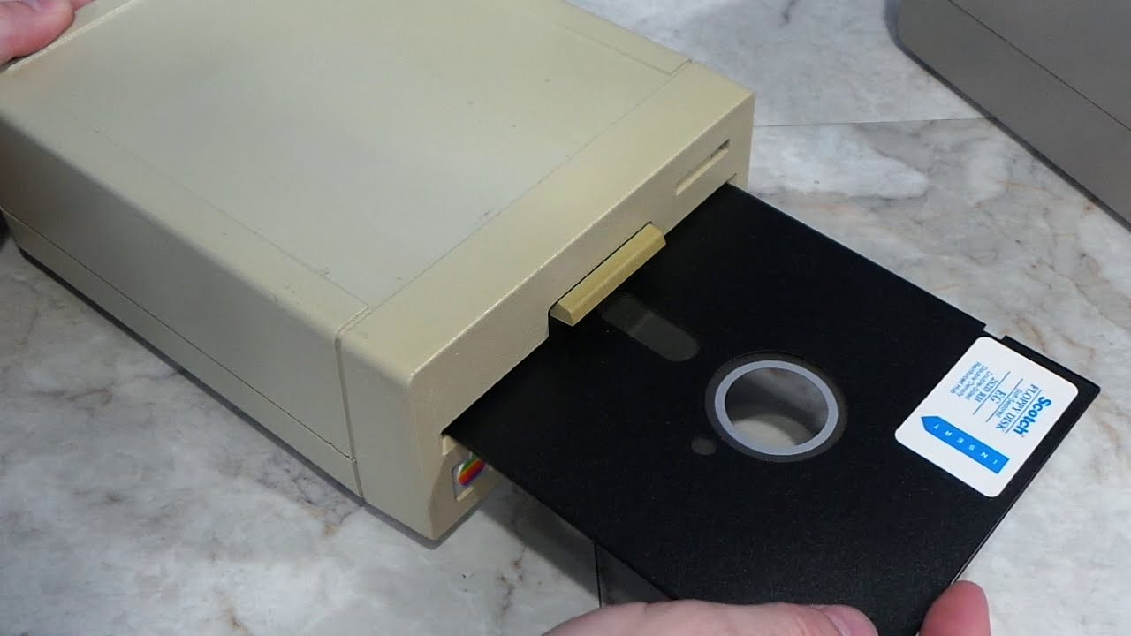
Introduction
Loading data into R.
Data format: csv as default, xls, and other methods to highlight that packages can expand R capabilities.
read.csv(file.choose()).
Understanding the working directory.
Loading data directly from a file (read.csv(“filename.csv”).
Exercise: Load a file using file.choose() and directly from file.

Slide 6
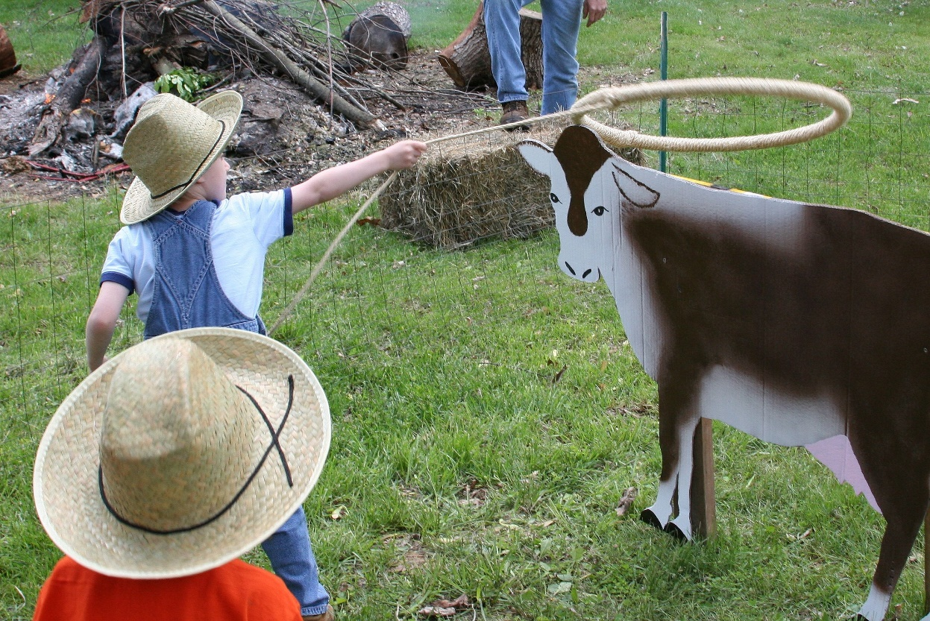
Data Wrangling
Data wrangling
Primarily working with dataframes
Adding columns, specifying with $
New column as old*static value, as old*a third column, etc.
Removing columns
Exercise: Add a new column to a dataframe (multiplying values), then remove a column.
Selection using [ ] to select columns, rows, and individual cells.
Exercise: Remove another column using [ ], then change a value in a specific cell.
Subset() and related functions to select data by criteria
Exercise: Use subset to filter data based on criteria (e.g., to a single site).
Tidy Data
Explanation of what tidy data is (not the tidyverse!)
Tidying data in R
How R handles missing values (“NA”)
Using is.na() to replace missing values.
Exercise: Use is.na() to replace one columns missing variables with an average.
Using complete.cases() to omit rows with missing data.
Exercise: Use complete.cases() to remove all rows with incomplete data.
Merge() and other joins.
Exercise: Merge the two dataframes we’ve been working with into a single table.

Slide 7
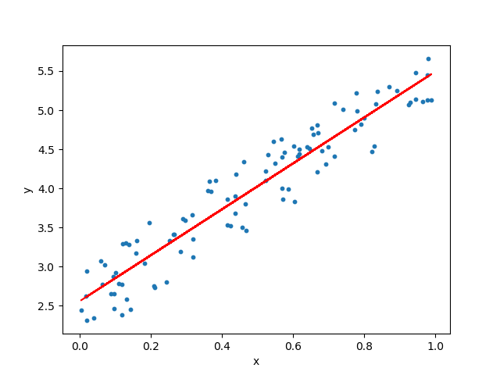
Analysis
Built-in analyses
summary()
lm()
Exercise: Summarize the new table, then create a linear model.

Slide 8
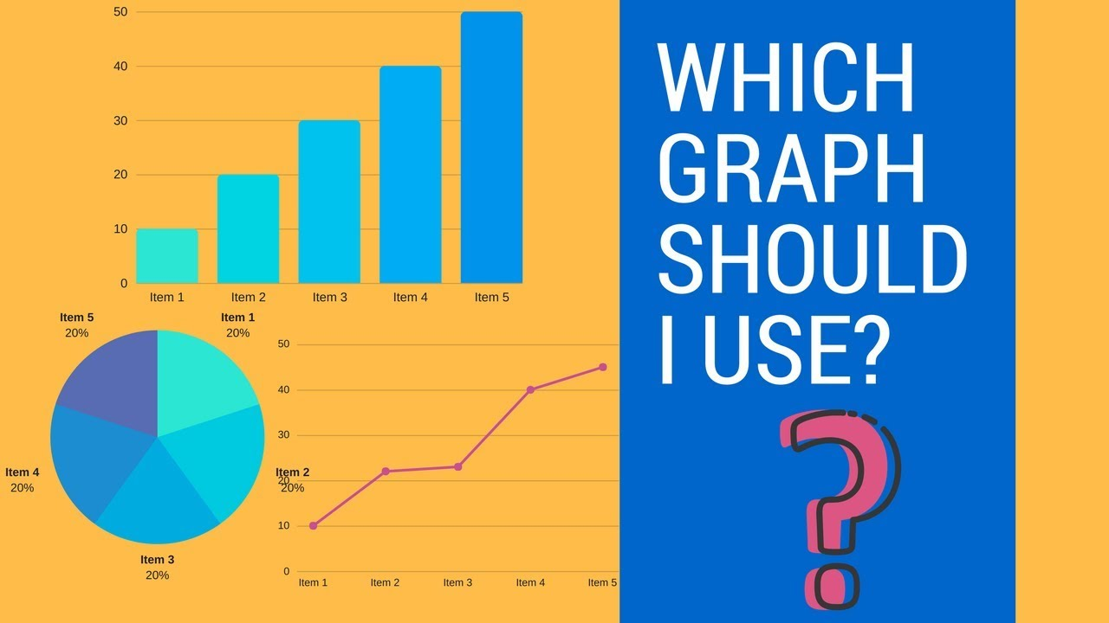
Plotting
Plotting
plot() and its arguments
Scatterplot
Exercise: Scatterplot and add regression line using abline()
Lineplot
Exercise: Lineplot
Histogram/barplot
Exercise: Histogram
Boxplots
Exercise: Boxplot
Adding labels, legends, and other elements.
Exercise: Add axes labels, change colors, and add legend.
Highlight ggplot2 and lattice for more complicated plots.

Slide 9

Saving Your Work
Saving objects
Using GUI in rStudio
Using code in source
Exercise: Save two different versions of the plot, using each method.

Slide 10

Where can you go from here?
R workflow and best practices
Installing and updating packages, handling library calls.
Examples of deeper things you can do with R
Loops
Figures & analyses
Maps
Complete reports (e.g., Lara’s weekly report)
Animations
Interactive shiny applications
Database QC
Plug useful packages and close out with questions or further applications, highlighting resources like bay-delta r user group,

